Slide 1

Prefetching for Linked Data Structure
Liang Yan
Computer Science Dep.
04/15/14

Slide 2

Outline
Introduction
  Why Prefetching?
  How Prefetching?
Motivation
Background
Prefetching implement
Evaluation
Summary

Slide 3
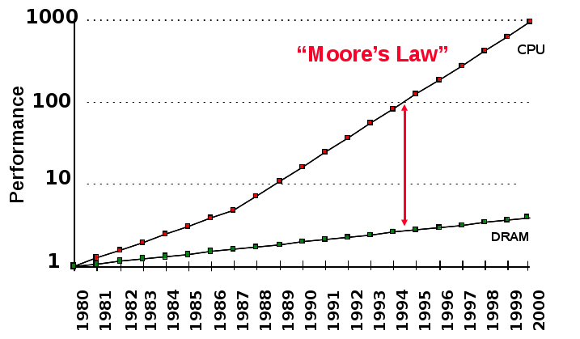
Memory Wall
Processor-memory gap grows over time
Processor-Memory
Performance Gap:
(grows 50% / year)
Notes:
Memory Wall is a well known problem in the computer architecture community. This graph tells us that the CPU performance increases 60% per year, while the DRAM performance only increases 10% per year. The result of this performance gap is that the CPU stalls most of time waiting for data sent up from the main memory. Therefore, techniques to hide memory latency is essential to deliver a high performance computer system. Prefetching is a commonly used technique to hide memory latency. The idea of prefetching is to issue a memory request earlier than demand fetch so data can arrive at the CPU earlier to reduce some of the memory stall time. There are two issues that we need to address when we design a prefetching scheme. The first issue is to determine what to prefetch; that requires a future address prediction mechanism. The second issue is to determine when we should issue a prefetch request. That is the prefetch schedule problem. Prefetching has been well studied for array-based applications. But there are still challenges to apply prefetching to pointer-based applications

Slide 4
Memory Wall
Roughly:
CPU
1 cycle
L1 cache
~1-5 cycles
L2 cache
~5-20 cycles
Main memory
~40-100 cycles

Slide 5
Hide the Memory Latency
Many techniques have been proposed to further hide/tolerate the increasing memory latency.
  For example
    Caches
    Locality optimization
    Pipelining
    Out-of-order execution
    Multithreading
Prefetching is one of the well studied techniques to hide memory latency too.
  Some prefetching schemes have already been adopted in commercial processors.

Slide 6
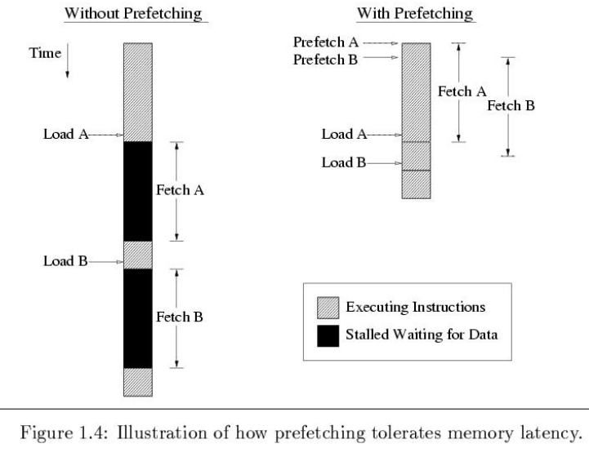
How Prefetching Works?

Slide 7
Outline
Introduction
Motivation
  Prefetch classification
  Mainly work
Background
Prefetching implement
Evaluation
Summary

Slide 8
Prefetching Classification
Various prefetching techniques have been proposed.
  1. Instruction Prefetching vs. Data Prefetching
  2. Software-controlled prefetching vs.
  Hardware-controlled prefetching vs.
  Hybrid-controlled prefetching .
  Data prefetching for different structures in general purpose programs:
    Prefetching for array structures.
    Prefetching for pointer and linked data structures.

Slide 9
Mainly research work
Granularity
Fine-grain prefetch, maily about the linkded data itself
Point-chasing
Jump-pointer
Coarse-grain pretch, based on content or context of data
CDP & ECDP & GRP
Processing side
Processor-side prefetch
Memory-side prefetch

Slide 10
Outline
Introduction
Motivation
Background
  What's LDS
  The test benchmark
Prefetching implement
Evaluation
Summary

Slide 11
LDS
LDS is called linked data structure, is mainly used in object-oriented programming, database, hash-table. It becomes more and more important recently. However, not like array, prefetching LDS is difficult because separate dynamically allocated objects are disjoint, and the access patterns are thus less regular and predictable.

Slide 12
LDS
Linked data structures
p = head;
while (p)
{
work (p->data);
p = p -> next;
}
p
*p
…..
currently visiting
would like to prefetch
No regularity in the address stream
Adjacent elements are not necessarily contiguous in memory

Slide 13
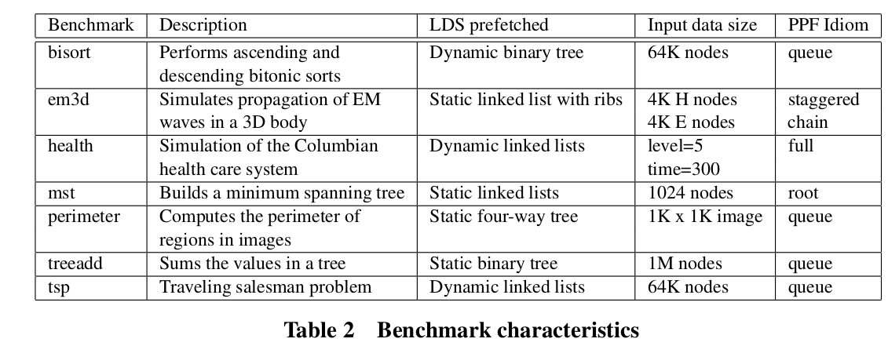
The oden benchmark suite

Slide 14
Outline
Introduction
Motivation
Prefetching implementation
  Pointer-chasing prefetch
  Jump-pointer prefetch
  Memory-side prefetch
  Coarse-grain prefetch
Evaluation
Summary

Slide 15
Pointer-chasing prefetch
Traversal of lists may exhibit poor temporal locality
Results in chains of data dependent loads,
called pointer-chasing
The basic algorithm for this question is Greedy algorithm which prefetch all the pointers (children) when a node is visited.

Slide 16
Greedy Prefetching
List Traversal
struct t{
stuct t *next,
data value} *p;
while(...){
work(p->data);
p = p->next;
prefetch(p->next);
}

Slide 17
Greedy Prefetching
Tree traversal
struct t{
stuct t *left,*right;
data value} *p;
foo(struct t *p){
prefetch(p->left);
prefetch(p->right);
work(p->data);
foo(p->left);
foo(p->right);
}

Slide 18
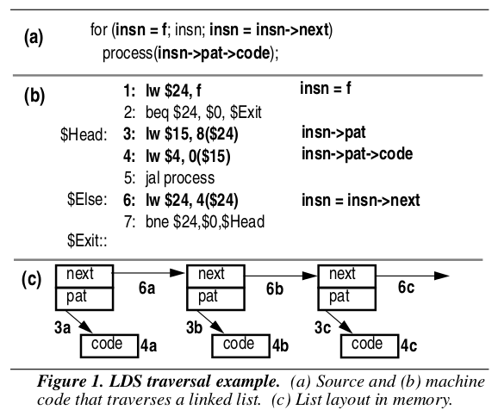
Pointer-chasing prefetch
Accoring to Amir's work,”Dependence based prefetching for linked data structures”
This kind of data is divided to:
1. recurrent-load
(Instr.6)
2. traversal-load
(Instr.3)
3. data-load
(Instr.4)

Slide 19
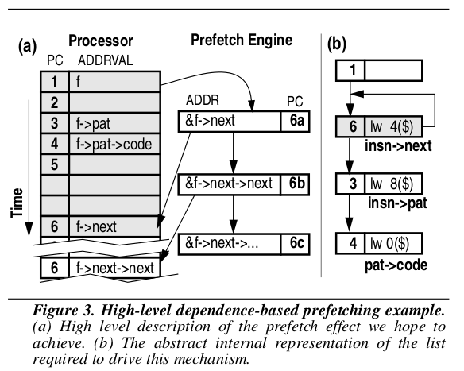
Dependence based prefetch

Slide 20
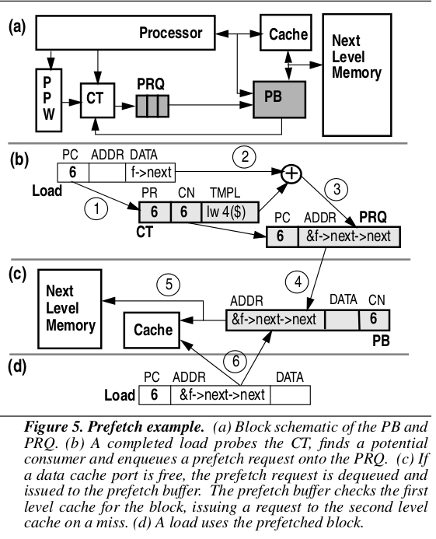
Dependence based prefetch
the Correlation Table (CT)
the Potential
Producer Window (PPW)
Prefetch Request Queue (PRQ)
Prefetch Buffer (PB)

Slide 21
Jump-pointer prefetch
Prefetch indirectly connected objects
  Tolerates more latency than greedy prefetching
Algorithm contains three steps:
  Find linked data structure traversal and creation sites
  Create jump-pointers
    When creating or traversing the linked structure
  Schedule prefetches
    Prefetch special jump-pointer field

Slide 22
Jump-pointer prefetch
Prefetch indirectly connected objects
  Tolerates more latency than greedy prefetching
Algorithm contains three steps:
  Find linked data structure traversal and creation sites
  Create jump-pointers
    When creating or traversing the linked structure
  Schedule prefetches
    Prefetch special jump-pointer field

Slide 23
Inserting Jump-Pointers at Creation Time
Jump-pointer prefetch
Void add(ObjType o) {
ListNode n = new ListNode(o);
jumpObj = jumpQueue[i];
jumpObj.jmp = n;
jumpQueue[i++%size] = n;
if (head == null) {
head = n;
} else {
tail.next = n;
}
tail = n;
}
1
2
3
4
5
jumpObj n

Slide 24
Jump-Pointer Prefetching Example
Jump-pointer prefetch
Doubly linked list
Jump-pointer prefetching
int sum (Dlist l) {
int s = 0;
while (l != null) {
prefetch(l.jmp);
s += l.data;
l = l.next;
}
return s;
}

Slide 25
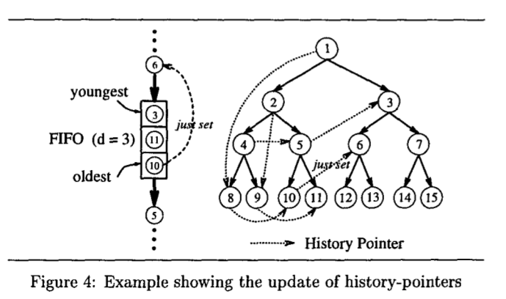
Jump-pointer prefetch
History-Pointer Prefetching

Slide 26
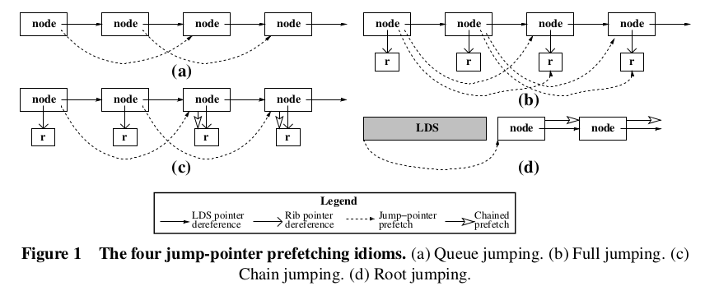
Jump-pointer prefetch
Roth and Sohi propose four different idioms for jump-pointer prefetching, as described below.

Slide 27
Jump-pointer prefetch
Jump-pointer prefetches and chained prefetches can combine to create efficient prefetching solutions.
Full jumping uses jump-pointer prefetches exclusively.
Root jumping uses few jump-pointer prefetches, and relies heavily on chained prefetching.
Chain jumping is somewhere in the middle.
Queue jumping is a special case that handles simple structures using jump-pointer prefetches only.

Slide 28
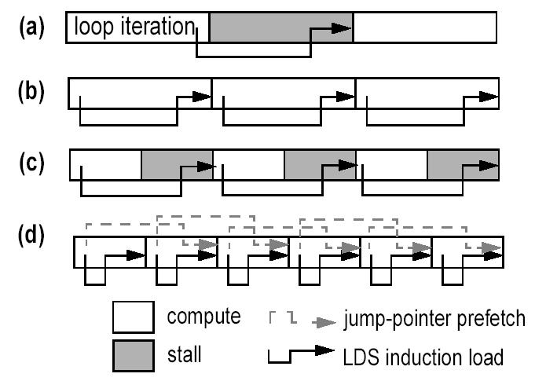
Jump-pointer prefetch

Slide 29
Jump Pointers – Roth’99
We present three: software-only, hardware-only, and a
cooperative scheme in which jump-pointer prefetching is
done in software and chained prefetching is handled in
Hardware. Although it is possible for software and hard-
ware to cooperate in reversed roles, this final combination makes little sense in terms of both complexity and performance.

Slide 30
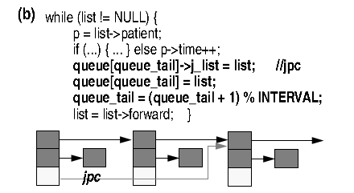
Jump Pointers – Roth’99
.
When prefetching, the distance (in dynamic nodes traversed) between the home and target nodes of a jump-pointer should be proportional to the target node access latency. For instance, if each node visit contains 10 cycles
of work and node access takes 40 cycles, a jump-pointer’s
home node should be four nodes ahead of its target node.

Slide 31
Coarse-grain prefetch
Usually, Prefetch focus on the operand of the instruction, analysis what kind of type it is, jump-pointer or pointer-chasing, however, it could still get a surprise performance when focus on the cache block of memory, some data features could work well too.

Slide 32
Content Directed Prefetching
A specialized prefetcher for pointer values
Cooksey et al., “A stateless, content-directed data prefetching mechanism,” ASPLOS 2002.
Idea: Identify pointers among all values in a fetched cache block and issue prefetch requests for them.
+ No need to memorize/record past addresses!
+ Can eliminate compulsory misses (never-seen pointers)
-- Indiscriminately prefetches all pointers in a cache block
How to identify pointer addresses:
Compares high order bits of values within cache line with cache line’s address. Generates prefetch requests on a match

Slide 33
Content Directed Prefetching
X800
22220
x40373551
x80011100
[31:20]
x800
11100
[31:20]
[31:20]
[31:20]
[31:20]
[31:20]
[31:20]
[31:20]
[31:20]
=
=
=
=
=
=
=
=
Virtual Address Predictor
Generate Prefetch
X80022220
L2
DRAM
…
…

Slide 34
Content Directed Prefetching
Shortcoming:
CDP prefetches all identified pointers
Indiscriminate prefetching of all discovered pointers leads to:
Low prefetch accuracy
High cache pollution
High bandwidth consumption

Slide 35
Making CDP Efficient: ECDP
Hardware does not have enough information on pointers
Software does (and can profile to get more information)
Idea:
  Compiler profiles and provides hints as to which pointer addresses(Pointer group,within offset limitation) are likely-useful to prefetch.
  Hardware uses hints to prefetch only likely-useful pointers.
Ebrahimi et al., “Techniques for Bandwidth-Efficient Prefetching of Linked Data Structures in Hybrid Prefetching Systems,” HPCA 2009.

Slide 36
Making CDP Efficient : GRP
Hardware does not have enough information on pointers
Software does (and can profile to get more information)
Idea:
Compiler analysis is used to produce a rich set
of load hints, including the presence or absence of spatial locality,
pointer structures, or indirect array accesses.
A runtime hardware engine, triggered by L2 cache misses, generates prefetches based on the compiler’s hints
Zhenlin Wang et al., “Guided Region Prefetching:
A Cooperative Hardware/Software Approach,” ISCA '03.

Slide 37
Memory-side Prefetch
A LDS prefetching framework built on a novel data movement model - Push (Yang’2000)
Traditional Pull Model
New Push Model
L1
L1
req
L2
L2
req
Main Memory
Main Memory
Notes:
This paper proposed a prefetching framework designed specifically for linked data structures. It is called the push architecture because it is based on the push model that we proposed in our previous work. In the conventional memory hierarchy, requests are sent down from the upper level to pull cache blocks up. So it is referred to as the pull model. In contrast, The push model that we proposed allows cache blocks to be pushed up the memory hierarchy pro-actively without corresponding requests sent from the upper level. Now the question is how the epush model helps prefetching linked data structures? I will give you the answer shortly.

Slide 38
The Push Architecture
Prefetch Buffer
prefetch req
Prefetch Engine
L1
L2 Bus
prefetch req
Prefetch Engine
L2
Memory Bus
Main
Memory
prefetch req
Prefetch Engine

Slide 39
The Push Architecture
Push model
L1
r1
x1
1
2
3
4
a1
L2
r2
x2
a2
Main Memory
r1
a1
r2
a2
x2
x1
a2
PFE
1
a2
x2
x1
2
a2
3

Slide 40
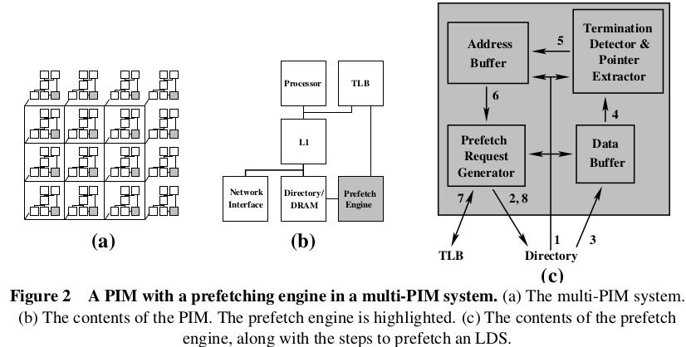
Memory-side Prefetch
“Memory-Side Prefetching for Linked Data Structures”
Christopher J. Hughes and Sarita Adve

Slide 41
Evaluation
Dependence-based prefetching achieves speedups of up to 25% on a suite of pointer-intensive programs.
JPP: On a suite of pointer intensive programs, jump-
pointer prefetching reduces memory stall time by 72% for
software, 83% for cooperative and 55% for hardware, pro-
ducing speedups of 15%, 20% and 22% respectively.

Slide 42
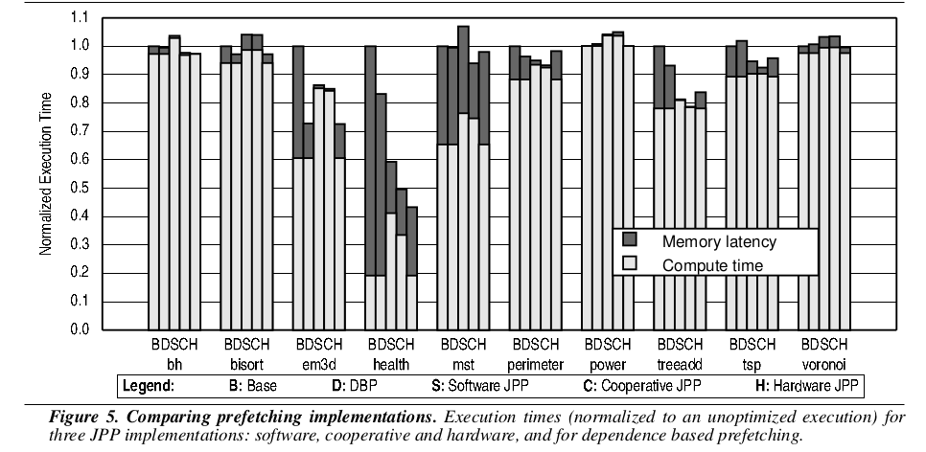
Evaluation

Slide 43
Evaluation
ECDP: Evaluations show that the proposed solution improves average performance by 22.5% while decreasing memory bandwidth consumption by 25% over a baseline system that employs an effective stream prefetcher on a set of memory- and pointer-intensive applications.
Memory-side: five of the benchmarks see significant improvements in performance from MPF (19%
to 62%), while the other two, bisort and perimeter, see an insignificant change. The average reduction in
execution time over the six benchmarks with significant LDS stall time (i.e., excluding perimeter) is 27%.

Slide 44
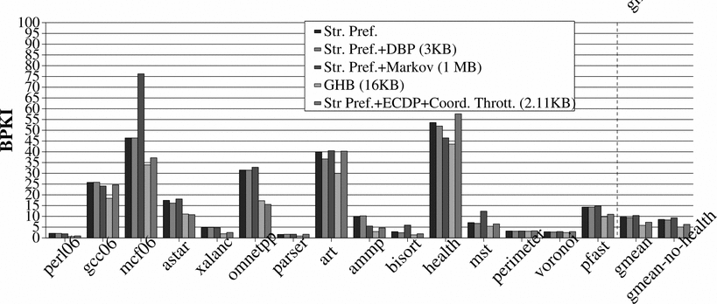
Evaluation
BPKI - bus accesses per thousand retired instructions

Slide 45
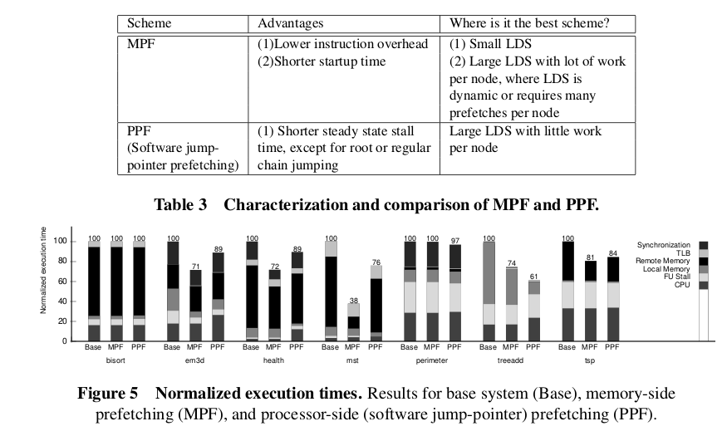
Evaluation

Slide 46
Summary
We know some basic algorithm for LDS from Luk et al., such as Greedy algorithm for Pointer-chasing and history table for jump pointer. Roth et al. did a lot of work on both aspects, They provided four idioms for jump-pointer and three data type for pointer-chasing,they also developed various methods for different LDS. Cooksey et al. Ebrahimi et al. And Wang et al. gave us a coarse grain perspective to think this question again. At last, Yang et al. And Kohout et al. Let us treat these question in a oppsite side.
According to these research, we know that LDS is a complicated data structure, there is not a perfect method to deal with, we need to make a adaptive decision based on different application.

Slide 47

Question ?
Thank
You!
Enjoy
the
comming
Summer
before
It is
gone!

